Slide 1


3 NF

Slide 2


List of Content
What is 3NF ?
Example

Slide 3

What is 3 NF ?
A relation is in third normal form, if:
it is in second normal form and
there is no transitive dependency for non-prime attributes

Slide 4
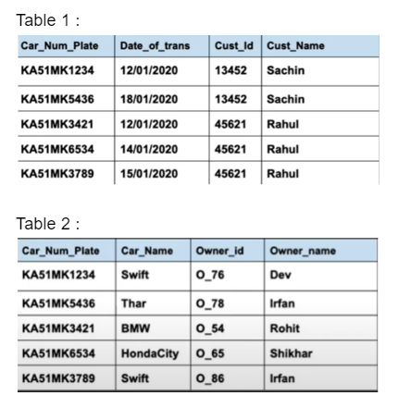

Example :

Slide 5
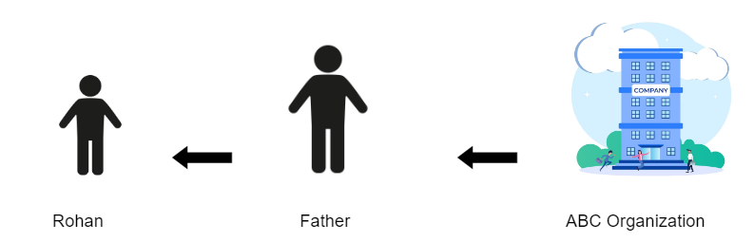
Transitive dependency
Notes:
Rohan’s father works for an organization ABC and earns his monthly compensation. He gives some of it to Rohan as his pocket money. Hence, in a way we can say that Rohan will get his pocket money only if his father is being paid by ABC and Rohan is indirectly dependent on ABC. If the organization stops the monthly compensation of father, Rohan will stop receiving pocket money.
This indirect dependency is known as transitive dependency.

Slide 6
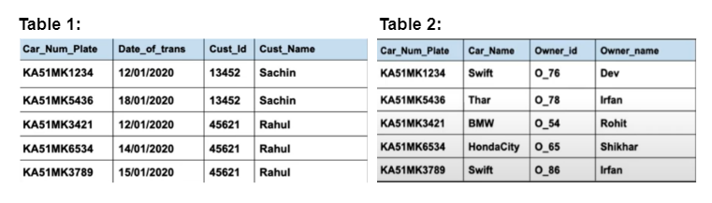
3 NF

Slide 7
THANK YOU

